Slide 1
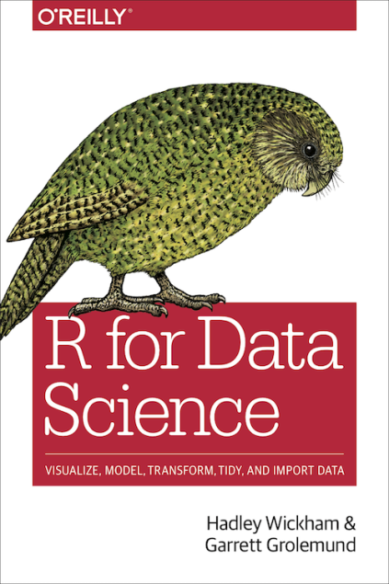
Chapter 6: Workflow: scripts
R for Data Science, Wickham & Grolemund

Slide 2
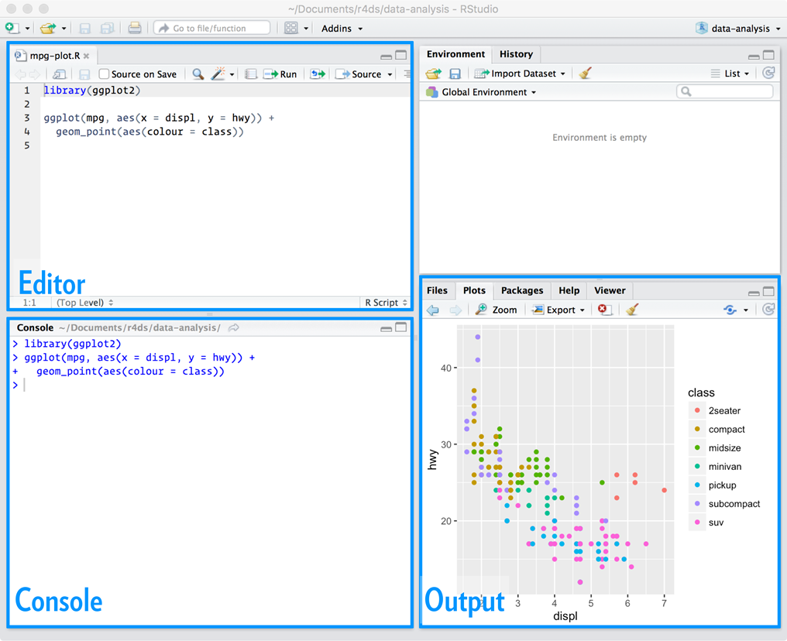

From console to editor
New file ->
R Script ->
Cmd + Ctrl + Shift + N

Slide 3
Console vs. editor
Console | Editor
Experimenting with scripts | To save code that actually works
Not automatically saved, easily ‘broomed’ | Automatically saved (caution)
Limited space for long code | More space for pipes, complex ggplot2 plots, long dplyr manipulations

Slide 4
Quickly running a script
Executing a line of code: Cmd/Ctrl + Enter
Executing the whole script: Cmd/Ctrl + Shift+S

Slide 5
Installing packages and working directory
setwd ()
install.packages ()

Slide 6
https://twitter.com/rstudiotips
https://support.rstudio.com/hc/en-us/articles/205753617-Code-Diagnostics

